Slide 1
Fully Parallel Architectures: FPGAs, Pipelining and Systolic arrays
Andrew W. Rose
Image credit to Sophia Shao @ UC Berkley & Vivienne Sze @ MIT

Slide 2
Before we start…
6pm | 7pm | 8pm | 9pm | 10pm | 11pm | 12pm | 01am | 02am | 03am

Slide 3
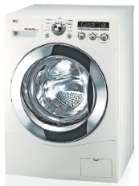
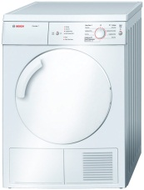
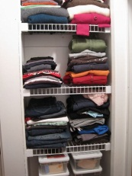
Sequential processing
6pm | 7pm | 8pm | 9pm | 10pm | 11pm | 12pm | 01am | 02am | 03am

Slide 4
Sequential processing
6pm | 7pm | 8pm | 9pm | 10pm | 11pm | 12pm | 01am | 02am | 03am
That would just be stupid

Slide 5
Sequential processing
6pm | 7pm | 8pm | 9pm | 10pm | 11pm | 12pm | 01am | 02am | 03am
That would just be stupid
But this is essentially what a CPU does

Slide 6
Pipelined processing
6pm | 7pm | 8pm | 9pm | 10pm | 11pm | 12pm | 01am | 02am | 03am

Slide 7
Pipelined processing
6pm | 7pm | 8pm | 9pm | 10pm | 11pm | 12pm | 01am | 02am | 03am
So why doesn’t my PC do this?

Slide 8
Pipelined processing
6pm | 7pm | 8pm | 9pm | 10pm | 11pm | 12pm | 01am | 02am | 03am
So why doesn’t my PC do this?
Because writing code like this is *really, really* hard

Slide 9
Recap: Field Programmable Gate Arrays (FPGAs)
2D array of Programmable Logic Blocks
Massive Fabric of Programmable Interconnects

Slide 10
Programmable Interconnect matrix

Slide 11
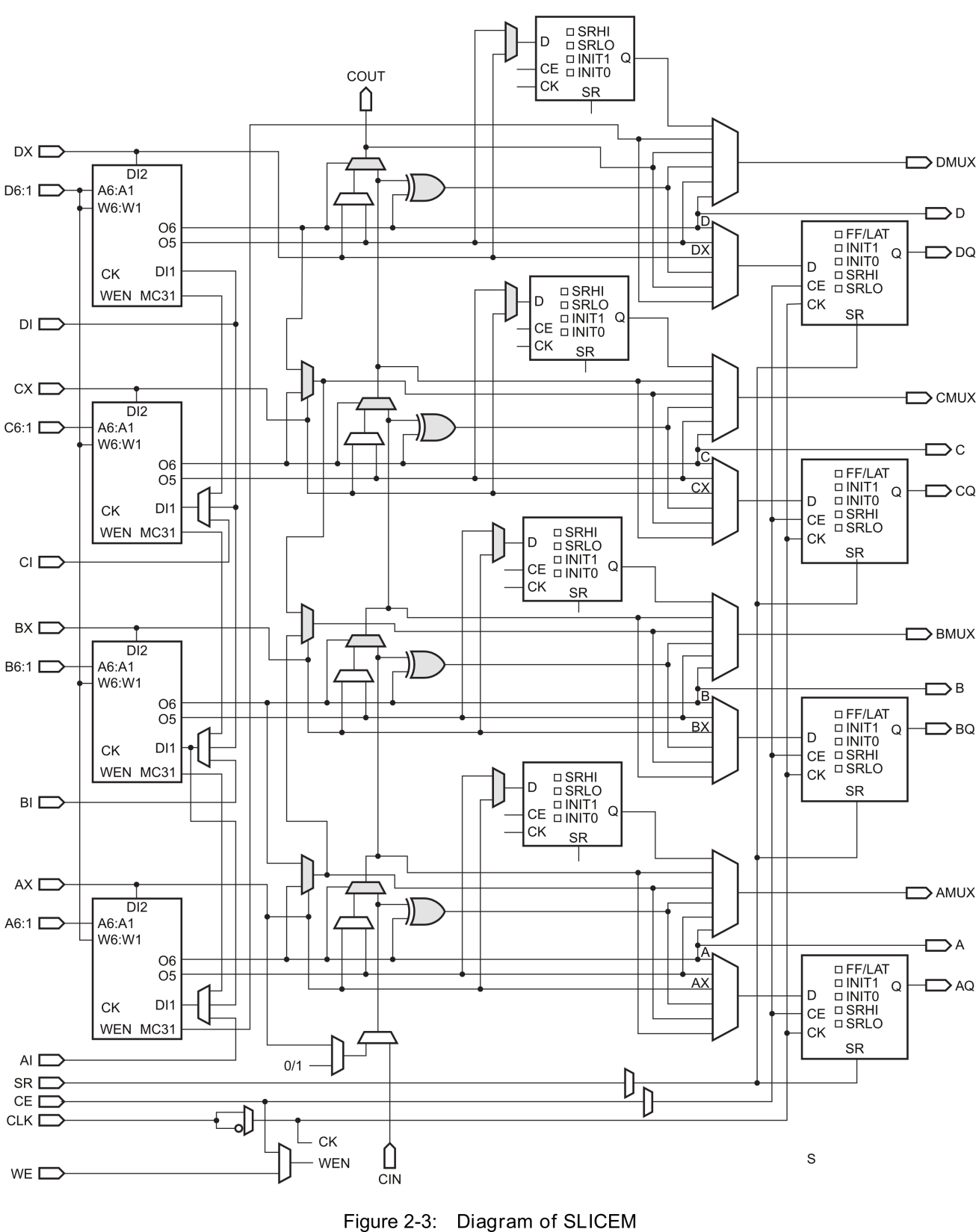
Combinatorial Logic Block
SRAM based look-up table to transform any input to any compile-time defined output

Slide 12
One way to use an FPGA
Data In
Data Out
Wait for the signal to propagate
“Sea-of-logic” approach

Slide 13
One way to use an FPGA
Data In
Data Out
Wait for the signal to propagate
“Sea-of-logic” approach
Constrained by the speed of light

Slide 14
Better…
Data In
Data In
Data Out
Wait for the signal to propagate
“Sea-of-logic” approach
Constrained by the speed of light
Do less
Clock the result

Slide 15
Better…
Data In
Data In
Data Out
Wait for the signal to propagate
“Sea-of-logic” approach
Constrained by the speed of light
Do less
Clock the result

Slide 16
Better…
Data In
Data In
Data Out
Wait for the signal to propagate
“Sea-of-logic” approach
Constrained by the speed of light
Do less
Clock the result

Slide 17
Better…
Data In
Data In
Data Out
Wait for the signal to propagate
“Sea-of-logic” approach
Constrained by the speed of light
Do less
Clock the result

Slide 18
Better…
Data In
Data In
Data Out
Wait for the signal to propagate
“Sea-of-logic” approach
Constrained by the speed of light
Do less
Clock the result

Slide 19
Better…
Data In
Data In
Data Out
Data Out
Wait for the signal to propagate
“Sea-of-logic” approach
Constrained by the speed of light
Do less
Clock the result
Doing less on each clock but compensated for by much higher clock speeds

Slide 20
Breaking down algorithms like this is HARD
“The parallel approach to computing does require that some original thinking be done about numerical analysis and data management in order to secure efficient use.
In an environment which has represented the absence of the need to think as the highest virtue, this is a decided disadvantage”
Daniel Slotnick, 1967
It's all about data-structure
It's all about data-structure
It's all about data-structure
It's all about data-structure
It's all about data-structure
It's all about data-structure
It's all about data-structure

Slide 21
But…
Accepting new data on every clock cycle is one extreme
Fully pipelined
"Full FPGA"

Slide 22
But…
Accepting new data on every clock cycle is one extreme
Fully pipelined
"Full FPGA"
Each block can accept new data less frequently than every clock cycle
Called the Interval

Slide 23
But…
Accepting new data on every clock cycle is one extreme
Fully pipelined
"Full FPGA"
Each block can accept new data less frequently than every clock cycle
Called the Interval
Each block can (but doesn't have to) emit data at a different rate to the input
Think of an accumulator receiving data every clock, and emitting and resetting the sum on every 10th clock cycle

Slide 24
But…
Accepting new data on every clock cycle is one extreme
Fully pipelined
"Full FPGA"
Each block can accept new data less frequently than every clock cycle
Called the Interval
Each block can (but doesn't have to) emit data at a different rate to the input
Think of an accumulator receiving data every clock, and emitting and resetting the sum on every 10th clock cycle
Or receiving data every 10th clock, and applying and outputting 10 different operations to that data

Slide 25
But…
Accepting new data on every clock cycle is one extreme
Fully pipelined
"Full FPGA"
Each block can accept new data less frequently than every clock cycle
Called the Interval
Each block can (but doesn't have to) emit data at a different rate to the input
Think of an accumulator receiving data every clock, and emitting and resetting the sum on every 10th clock cycle
Or receiving data every 10th clock, and applying and outputting 10 different operations to that data
We can still use the ideas of pipelining and 2D arrays
Referred to generically as Systolic arrays

Slide 26
Start simple: How do we add a lot of numbers?

Slide 27
Start simple: How do we add a lot of numbers?
The English say:
There's more than one way to skin a cat

Slide 28
Start simple: How do we add a lot of numbers?
Summation chain
Input
Input
Input
Input
Input
Input
Input
Input
Input
Input
+
+
+
+
+
+
+
+
+
+
Output

Slide 29
Start simple: How do we add a lot of numbers?
Accumulator
+
Input
Output

Slide 30
Start simple: How do we add a lot of numbers?
Tree adder
Input
+
Input
+
Input
+
Input
+
Output
Input
+
Input
+
Input
+
Input

Slide 31
Start simple: How do we add a lot of numbers?
Which is the best approach?

Slide 32
Start simple: How do we add a lot of numbers?
Which is the best approach?
Depends on your scenario

Slide 33
Start simple: How do we add a lot of numbers?
Which is the best approach?
Depends on your scenario
And there is no reason why you can't mix-and-match

Slide 34
Start simple: How do we add a lot of numbers?
Which is the best approach?
Depends on your scenario
And there is no reason why you can't mix-and-match
“The parallel approach to computing does require that some original thinking be done about numerical analysis and data management in order to secure efficient use.
In an environment which has represented the absence of the need to think as the highest virtue, this is a decided disadvantage”
Daniel Slotnick, 1967

Slide 35
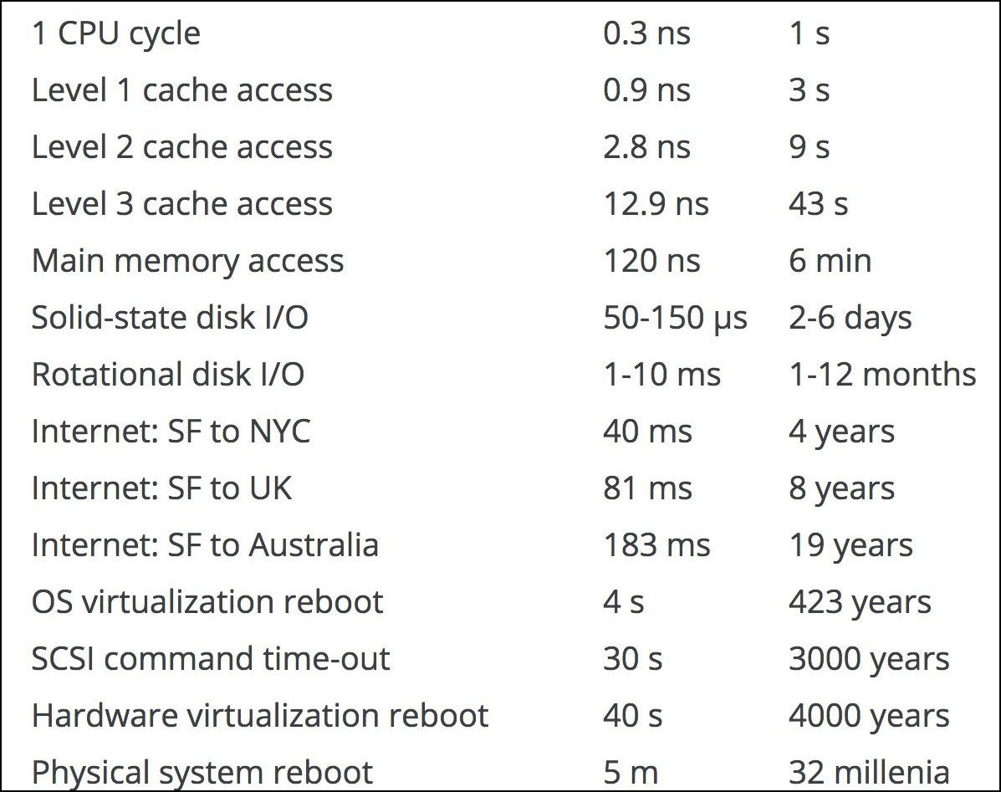
Recall
Accessing DRAM is EXPENSIVE
Accessing DRAM is SLOW

Slide 36
Recall: Memory Access is the Bottleneck
Weights
Inputs
Partial Sum
Updated partial Sum
Worst Case: all memory R/W are DRAM accesses
Example: AlexNet [NIPS 2012] has 724M MACs vs. 2896M DRAM accesses required

Slide 37
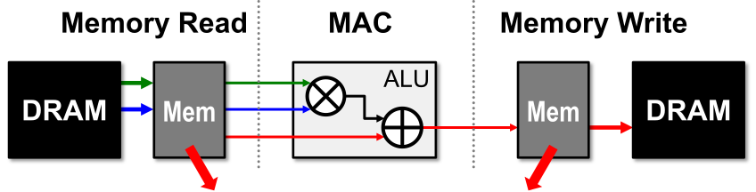
Recall: Leverage Local Memory for Data Reuse
Extra levels of local memory hierarchy
Smaller, but Faster and more Energy-Efficient
Allows elements to be reused
Temporal Reuse

Slide 38
Recall: Data Reuse in DNN
Filter
Input
Filter
Input
Filter
Input
Convolutional Reuse
(Conv layers only)
Reuse: Inputs
Weights
Input Reuse
(Conv and fully-connected layers) Reuse: Inputs
Filter Reuse
(Conv and fully-connected layers, batch size > 1) Reuse: Weights

Slide 39
Recall: Data Reuse in DNN
Filter
Input
Filter
Input
Filter
Input
Convolutional Reuse
(Conv layers only)
Reuse: Inputs
Weights
Input Reuse
(Conv and fully-connected layers) Reuse: Inputs
Filter Reuse
(Conv and fully-connected layers, batch size > 1) Reuse: Weights
If all data reuse is exploited, DRAM accesses in AlexNet can be reduced from 2896M to 61M (best case)

Slide 40
Single PE for GEMM (and by extension any NN)
Input Activation
ALU
or
Processing element
Register
MAC
Weight
Register
Register
Output Activation

Slide 41
Example: 1D convolution
Output Stationary (OS)
for( q=0; q<Q; q++ ){ for( s=0; s<S; s++ ){ O[q] += I[q+s] * W[s]; } }
Input
Weight
Output
×U
×S
×Q

Slide 42
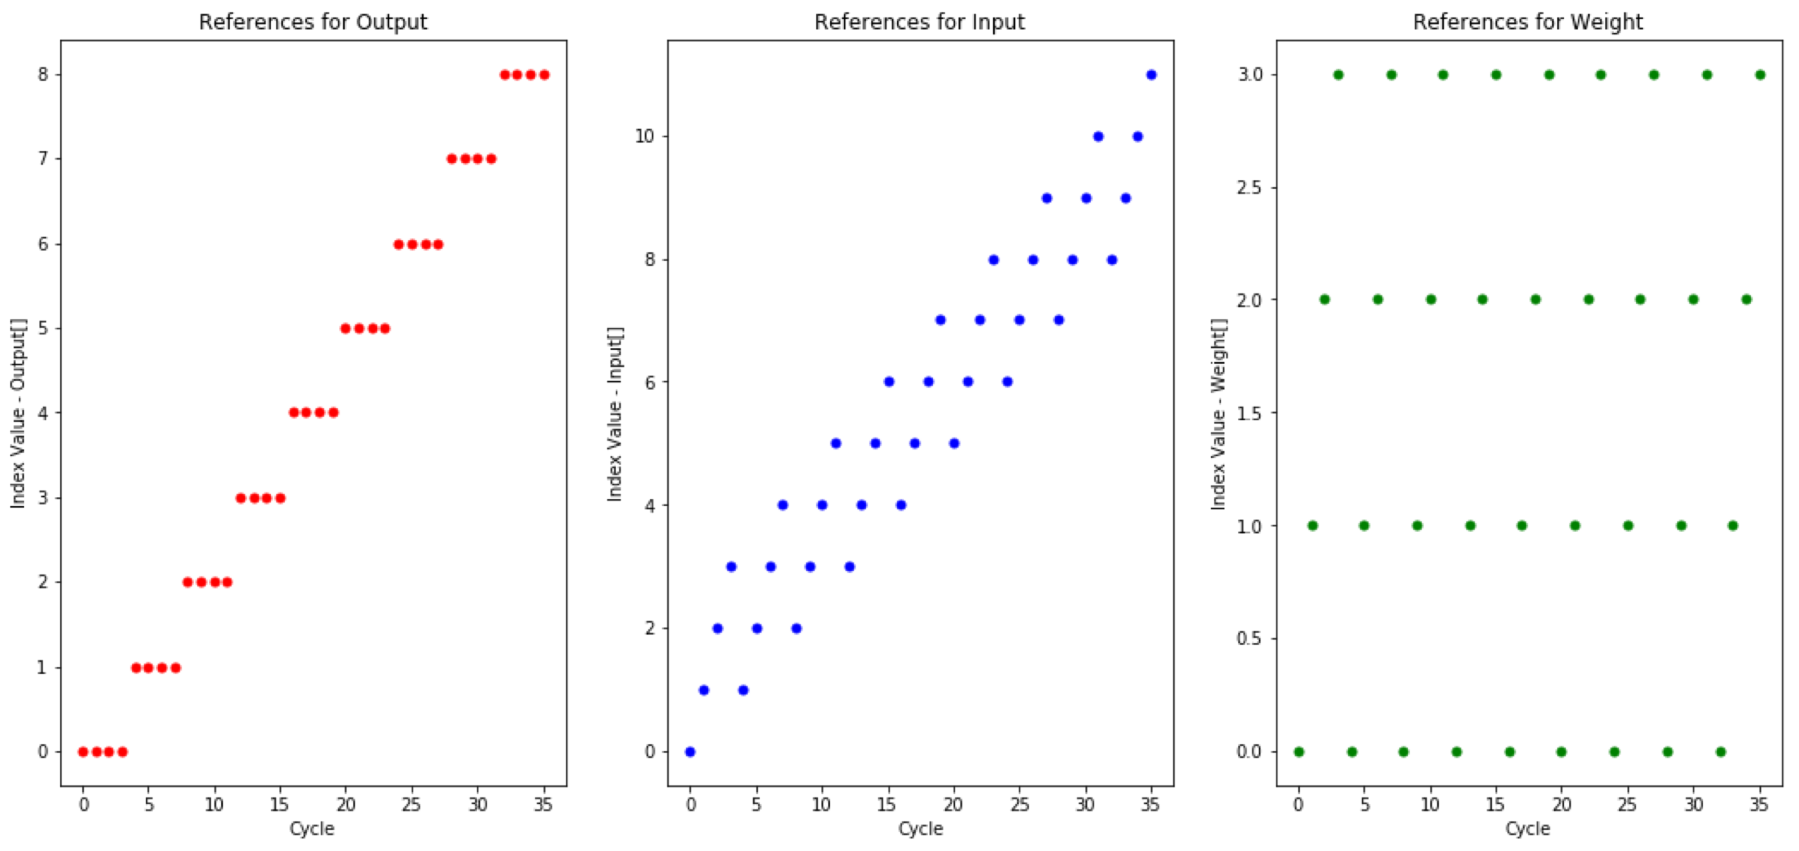
Output Stationary: Temporal reuse
for( q=0; q<Q; q++ ){ for( s=0; s<S; s++ ){ O[q] += I[q+s] * W[s]; } }
Input
Weight
Output
×U
×S
×Q

Slide 43
Output Stationary: Temporal reuse
for( q=0; q<Q; q++ ){ for( s=0; s<S; s++ ){ O[q] += I[q+s] * W[s]; } }
Input
Weight
Output
×U
×S
×Q
Each output used repeatedly

Slide 44
Output Stationary
Input Activation from Cache
The naïve way to implement it in our Processing Element
ALU
or
Processing element
MAC
Weight from Cache
Output Activation to/from Cache

Slide 45
Output Stationary
Input Activation from Cache
ALU
or
Processing element
MAC
Weight from Cache
Register
Output Activation to Cache
And only one RAM write required at the end of the accumulation

Slide 46
Example: 1D convolution
Output Stationary (OS)
for( q=0; q<Q; q++ ){ for( s=0; s<S; s++ ){ O[q] += I[q+s] * W[s]; } }
for( s=0; s<S; s++ ){ for( q=0; q<Q; q++ ){ O[q] += I[q+s] * W[s]; } }
Input
Weight
Output
×U
×S
×Q

Slide 47
Example: 1D convolution
Output Stationary (OS)
Weight Stationary (WS)
for( q=0; q<Q; q++ ){ for( s=0; s<S; s++ ){ O[q] += I[q+s] * W[s]; } }
for( s=0; s<S; s++ ){ for( q=0; q<Q; q++ ){ O[q] += I[q+s] * W[s]; } }
Input
Weight
Output
×U
×S
×Q

Slide 48
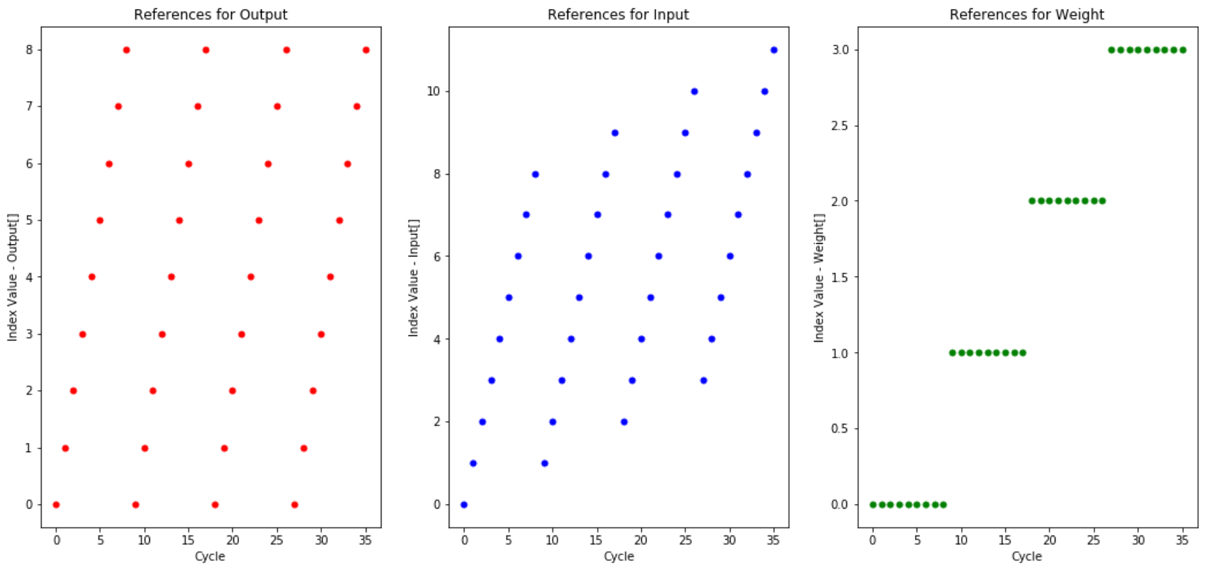
Weight Stationary: Temporal reuse
for( s=0; s<S; s++ ){ for( q=0; q<Q; q++ ){ O[q] += I[q+s] * W[s]; } }
Input
Weight
Output
×T
×S
×Q
Each weight used repeatedly

Slide 49
Weight Stationary
Input Activation from Cache
ALU
or
Processing element
MAC
Weight from Cache
Register
Output Activation to/from Cache

Slide 50
Of course, a third option: Input Stationary
Input Activation from Cache
Input
Weight
Output
ALU
or
Processing element
×U
×S
×Q
Register
for( q=0; q<Q; q++ ){ for( s=0; s<S; s++ ){ O[q] += I[q+s] * W[s]; } }
for( u=0; u<U; u++ ){ for( s=0; s<S; s++ ){ O[u-s] += I[u] * W[s]; } }
MAC
Weight from Cache
Output Activation to/from Cache
Beware:
u-s >= 0 u-s < Q

Slide 51
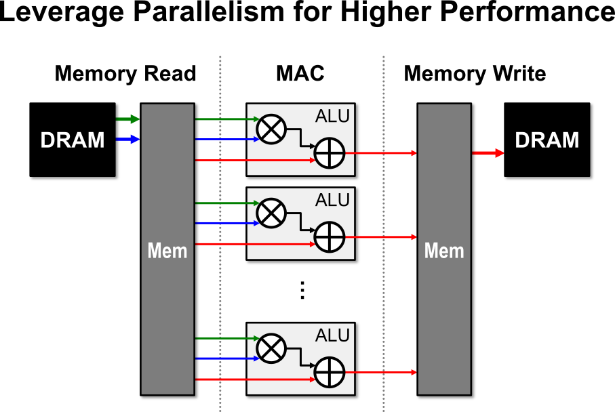
Use parallelism to improve compute performance

Slide 52
Highly-Parallel Compute Paradigms
Temporal Architecture (SIMD/SIMT)

Slide 53
Highly-Parallel Compute Paradigms
Temporal Architecture (SIMD/SIMT)
Spatial Architecture (Dataflow Processing)

Slide 54
So what can you do with dataflow processing?

Slide 55
Why systolic array processors?
Moving data from one ALU to another in a systolic array is *much, much* cheaper than moving data from DRAM
Cheaper even than from a local buffer/cache

Slide 56
Matrix Multiply
for( m=0; m<M; m++ ){ for( n=0; n<N; n++ ){ O[n, m] = 0; for( k=0; k<K; k++ ){ O[n, m] += I[m, k] * W[k, n]; } O[n, m] = Activation( O[n, m] ); } }

Slide 57
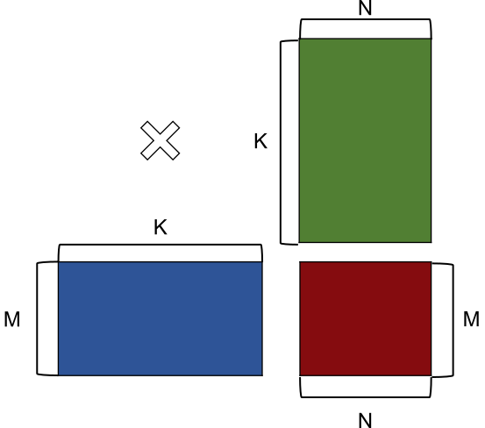
Matrix Multiply
for( m=0; m<M; m++ ){ for( n=0; n<N; n++ ){ O[n, m] = 0; spatial_for( k=0; k<K; k++ ){ O[n, m] += I[m, k] * W[k, n]; } O[n, m] = Activation( O[n, m] ); } }
Adder Tree
Typical width: 8-64
Applicable to any accumulation dimensions
E.g. NVDLA, DianNao
×
×
×
×
×
×
×
×
+
+
+
+
+
+
+
Output

Slide 58
Matrix Multiply
for( m=0; m<M; m++ ){ for( n=0; n<N; n++ ){ O[n, m] = 0; spatial_for( k=0; k<K; k++ ){ O[n, m] += I[m, k] * W[k, n]; } O[n, m] = Activation( O[n, m] ); } }
Adder Tree
Typical width: 8-256
Applicable to any accumulation dimensions
E.g. Google TPU, Gemmini
×
×
×
×
×
×
×
×
+
+
+
+
+
+
+
+
Output

Slide 59
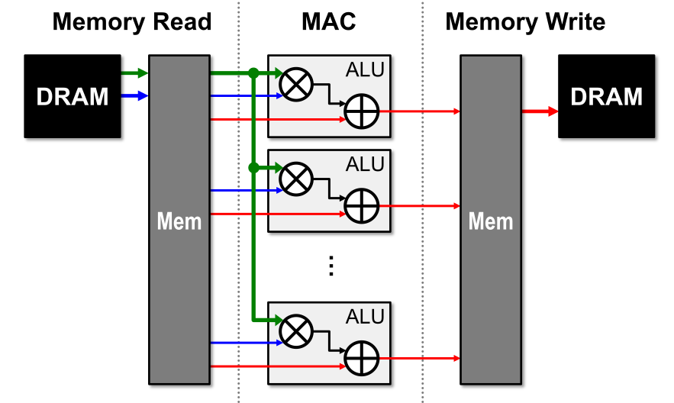
Can also use parallelism for Spatial Reuse

Slide 60
Can also use parallelism for Spatial Reuse
Direct-wiring Multicast
Up against the speed of light

Slide 61
Can also use parallelism for Spatial Reuse
Systolic Multicast
Registered at each step
Signal can go further
Clocks can run faster

Slide 62
Slightly more advanced PE
Input Activation
Processing element
Register
Weight
Forwarding
Register
MAC
Partial Sum
Output Activation
Register
Register

Slide 63
Matrix Multiply
spatial_for( m=0; m<M; m++ ){ for( n=0; n<N; n++ ){ O[n, m] = 0; for( k=0; k<K; k++ ){ O[n, m] += I[m, k] * W[k, n]; } O[n, m] = Activation( O[n, m] ); } }
Direct-wiring multicast
Typical width: 16
Applicable to any non-accumulation dimensions
E.g. NVDLA, DianNao
×
×
×
×
×
×
×
×
+
+
+
+
+
+
+
+

Slide 64
Matrix Multiply
spatial_for( m=0; m<M; m++ ){ for( n=0; n<N; n++ ){ O[n, m] = 0; for( k=0; k<K; k++ ){ O[n, m] += I[m, k] * W[k, n]; } O[n, m] = Activation( O[n, m] ); } }
Systolic multicast
Typical width: 8-256
Applicable to any non-accumulation dimensions
E.g. Google TPU, Gemmini
Register
Register
Register
×
×
×
×
+
+
+
+

Slide 65
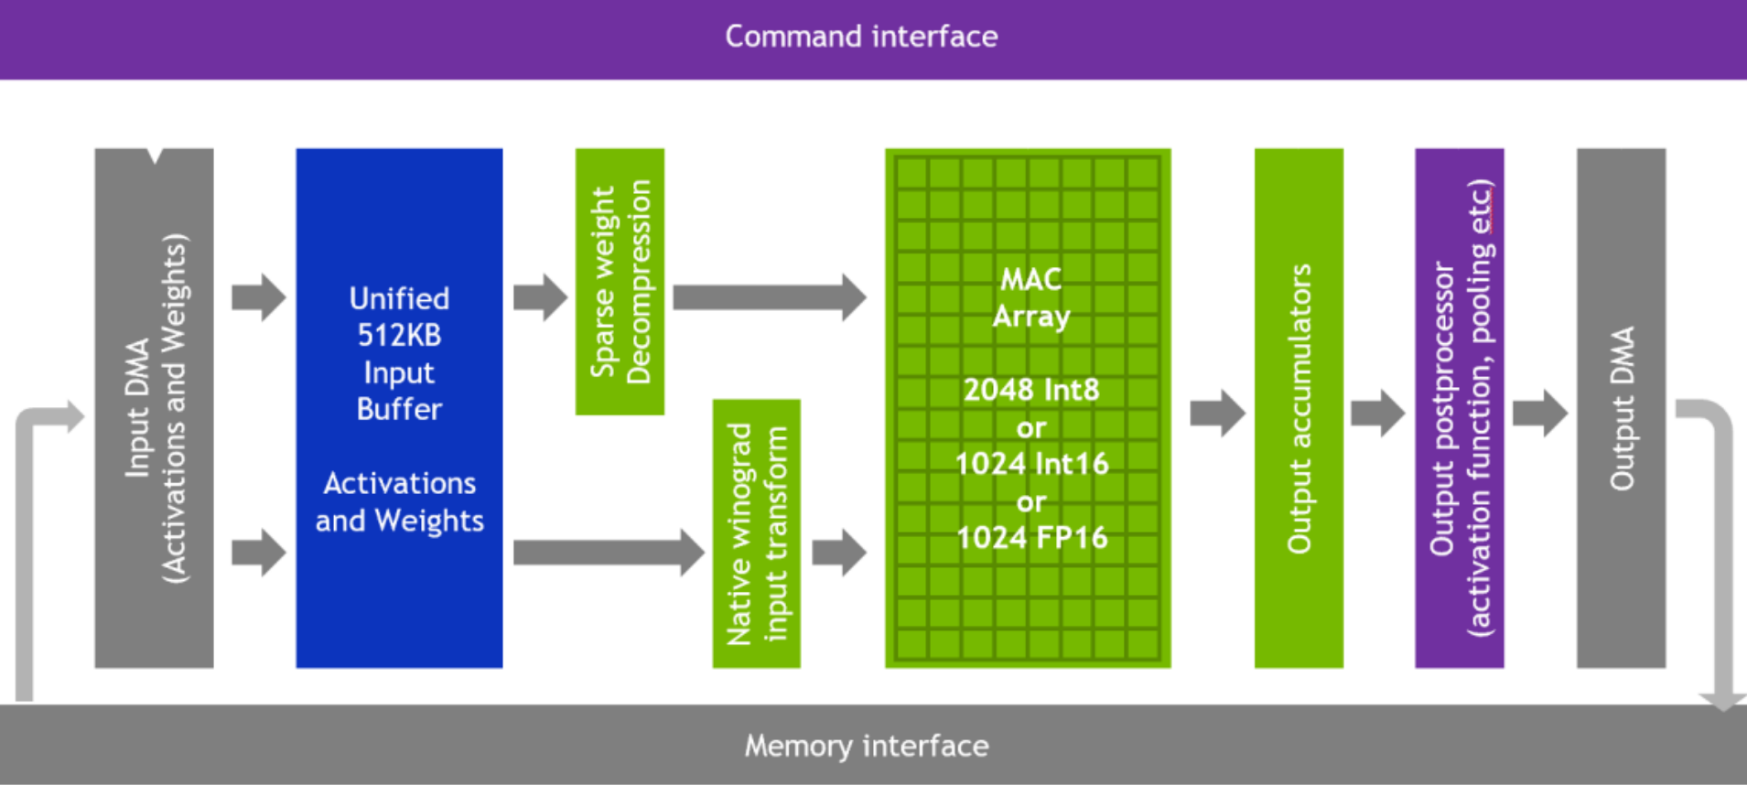
Put it together: NVDLA
spatial_for( m=0; m<M; m++ ){ for( n=0; n<N; n++ ){ O[n, m] = 0; spatial_for( k=0; k<K; k++ ){ O[n, m] += I[m, k] * W[k, n]; } O[n, m] = Activation( O[n, m] ); } }
Direct-wiring multicast
Adder Tree
×
×
×
×
×
×
×
×
×
×
×
×
×
×
×
×
×
×
×
×
×
×
×
×
×
×
×
×
×
×
×
×
+
+
+
+
+
+
+
+
+
+
+
+
+
+
+
+
+
+
+
+
+
+
+
+
+
+
+
+
Output
Output
Output
Output

Slide 66
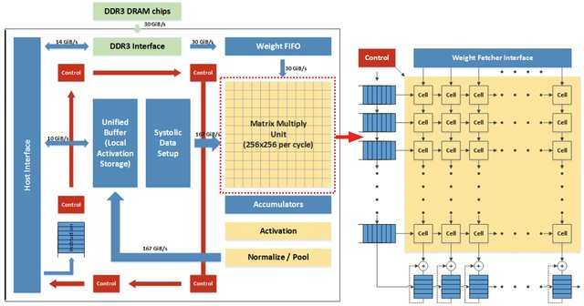
Put it together: Google TPU
spatial_for( m=0; m<M; m++ ){ for( n=0; n<N; n++ ){ O[n, m] = 0; spatial_for( k=0; k<K; k++ ){ O[n, m] += I[m, k] * W[k, n]; } O[n, m] = Activation( O[n, m] ); } }
Systolic multicast
Systolic accumulation
Reg
Reg
Reg
Reg
×
+
×
+
×
+
×
+
Reg
Reg
Reg
Reg
Reg
Reg
Reg
Reg
×
+
×
+
×
+
×
+
Reg
Reg
Reg
Reg
Reg
Reg
Reg
Reg
×
+
×
+
×
+
×
+
Reg
Reg
Reg
Reg
Reg
Reg
Reg
Reg
×
+
×
+
×
+
×
+
Reg
Reg
Reg
Reg

Slide 67
Put it together: Systolic TPU in action
Weights
PE
PE
PE
PE
Inputs
Outputs

Slide 68
Put it together: Systolic TPU in action
Preload weights into registers
Weight Stationary (WS)
Weights
PE
PE
b11
b12
PE
PE
b21
b22
Inputs
Outputs

Slide 69
Put it together: Systolic TPU in action
Optimally arrange your input
It's all about data-structure
Weights
PE
PE
b11
b12
a21
a11
PE
PE
b21
b22
a22
a12
Inputs
Outputs

Slide 70
Put it together: Systolic TPU in action
Clock the systolic array – clock 0
Weights
PE
PE
b11
b12
a21
a11
PE
PE
b21
b22
a22
a12
Inputs
Outputs

Slide 71
Put it together: Systolic TPU in action
Clock the systolic array – clock 0
Weights
PE
PE
b11
b12
a21
a11
a11.b11
PE
PE
b21
b22
a22
a12
Inputs
Outputs

Slide 72
Put it together: Systolic TPU in action
Clock the systolic array – clock 1
Weights
PE
PE
b11
b12
a21
a11
PE
PE
b21
b22
a11.b11
a22
a12
Inputs
Outputs

Slide 73
Put it together: Systolic TPU in action
Clock the systolic array – clock 1
Weights
PE
PE
b11
b12
a21
a11
a21.b11
a11.b12
PE
PE
b21
b22
a11.b11
a22
a12
a11.b11 +a12.b21
Inputs
Outputs

Slide 74
Put it together: Systolic TPU in action
Clock the systolic array – clock 1
Weights
PE
PE
b11
b12
a21
a11
a21.b11
a11.b12
PE
PE
b21
b22
a11.b11
a22
a12
c11
a11.b11 +a12.b21
Inputs
Outputs

Slide 75
Put it together: Systolic TPU in action
Clock the systolic array – clock 2
Weights
PE
PE
b11
b12
a21
a11
PE
PE
b21
b22
a21.b11
a11.b12
a22
a12
Inputs
Outputs

Slide 76
Put it together: Systolic TPU in action
Clock the systolic array – clock 2
Weights
PE
PE
b11
b12
a21
a11
a21.b12
PE
PE
b21
b22
a21.b11
a11.b12
a22
a12
a21.b11 +a22.b21
a11.b12 +a12.b22
Inputs
Outputs

Slide 77
Put it together: Systolic TPU in action
Clock the systolic array – clock 2
Weights
PE
PE
b11
b12
a21
a11
a21.b12
PE
PE
b21
b22
a21.b11
a11.b12
a22
a12
c21
c12
a21.b11 +a22.b21
a11.b12 +a12.b22
Inputs
Outputs

Slide 78
Put it together: Systolic TPU in action
Clock the systolic array – clock 3
Weights
PE
PE
b11
b12
a21
PE
PE
b21
b22
a21.b12
a12
a22
Inputs
Outputs

Slide 79
Put it together: Systolic TPU in action
Clock the systolic array – clock 3
Weights
PE
PE
b11
b12
a21
PE
PE
b21
b22
a21.b12
a12
a22
a21.b12 +a22.b22
Inputs
Outputs

Slide 80
Put it together: Systolic TPU in action
Clock the systolic array – clock 3
Weights
PE
PE
b11
b12
a21
PE
PE
b21
b22
a21.b12
a12
a22
c22
a21.b12 +a22.b22
Inputs
Outputs
Success!

Slide 81
Summary of dataflow architectures
Minimizing data movement is the key to achieving high energy efficiency for DNN accelerators
Dataflow taxonomy:
Output Stationary: minimize movement of partial sums
Weight Stationary: minimize movement of weights
Input Stationary: minimize movement of inputs
There are many ways to skin a cat
Which is the best approach? Depends on your scenario
And there is no reason why you can't mix-and-match approaches

Slide 82
Summary of dataflow architectures
With sequential-processing your data needs to be in the right place in a 1D memory
With data-flow processing your data needs to be in both the right place in an N-Dimensional space and at the right time
And that is why writing code like this is *really, really hard*

